Slide 1
Project On
NETFLIX MOVIES AND TV SHOWS CLUSTERING
Mangesh Bembade
Pratik Bhandare
Harikrishnan M
Pranav.P
Anith K

Slide 2

Introduction
Netflix is a company that manages a large collection of TV shows and movies, streaming it anytime via online. This business is profitable because users make a monthly payment to access the platform. However, customers
Netflix:
can cancel their subscriptions at any time.
Unsupervised Machine Learning (Clustering)
Methodology:
Netflix Movies and TV Shows
8786 rows and 12 columns
Data from last decade
Database:

Slide 3
Problem Statement
Netflix is the world's largest online streaming service provider, with over 220 million subscribers as of 2022-Q2. It is crucial that they effectively cluster the shows that are hosted on their platform in order to enhance the user experience, thereby preventing subscriber churn.
We will be able to understand the shows that are similar to and different from one another by creating clusters, which may be leveraged to offer the consumers personalized show suggestions depending on their preferences.
The goal of this project is to classify/group the Netflix shows into certain clusters such that the shows within a cluster are similar to each other and the shows in different clusters are dissimilar to each other.
In this project, you are required to do
Exploratory Data Analysis
Understanding what type content is available in different countries
Is Netflix has increasingly focusing on TV rather than movies in recent years.
Clustering similar content by matching text-based features

Slide 4

Data Description
The data was collected from Flixable which is third party Netflix
search engine. The dataset consists of movies and TV shows data till
2019. The dataset has 8787 rows of data.
The dataset consists of eleven textual columns and one numeric
column.
Attribute Information :
show_id : Unique ID for every Movie / Tv Show
type : Identiﬁer - A Movie or TV Show
title : Title of the Movie / Tv Show
director : Director of the Movie

Slide 5
Data Description
5. cast : Actors involved in the movie / show
6. country : Country where the movie / show was produced
7. date_added : Date it was added on Netﬂix
8. release_year : Actual Release year of the movie / show
9. rating : TV Rating of the movie / show
10. duration : Total Duration - in minutes or number of seasons
11. listed_in : Genre
12. description: The Summary description

Slide 6
Null Value
Null Value Treatment:
● Director feature have more than 30.68% of null values. Filling null values by ‘unknown’.
● Country feature have 6.51% of null values. Filling null values by mode of feature.
● Cast feature have 9.22% of null values. Filling null values by ‘unknown’.
● Rating feature have 0.09% of null values. Filling null values by mode of feature.
● Date_added feature have 0.13% of null values. Dropping rows corresponding to null values.

Slide 7
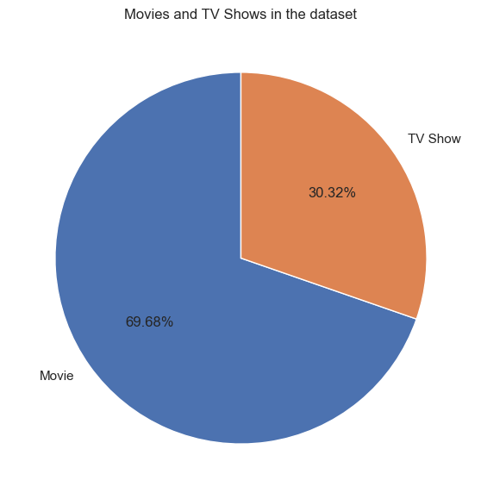
Exploratory Data Analysis
Type of content available on Netflix
•It is evident that there are more movies
on Netflix than TV shows.
•Netflix has 5377 movies, which is more
than double the quantity of TV shows.

Slide 8
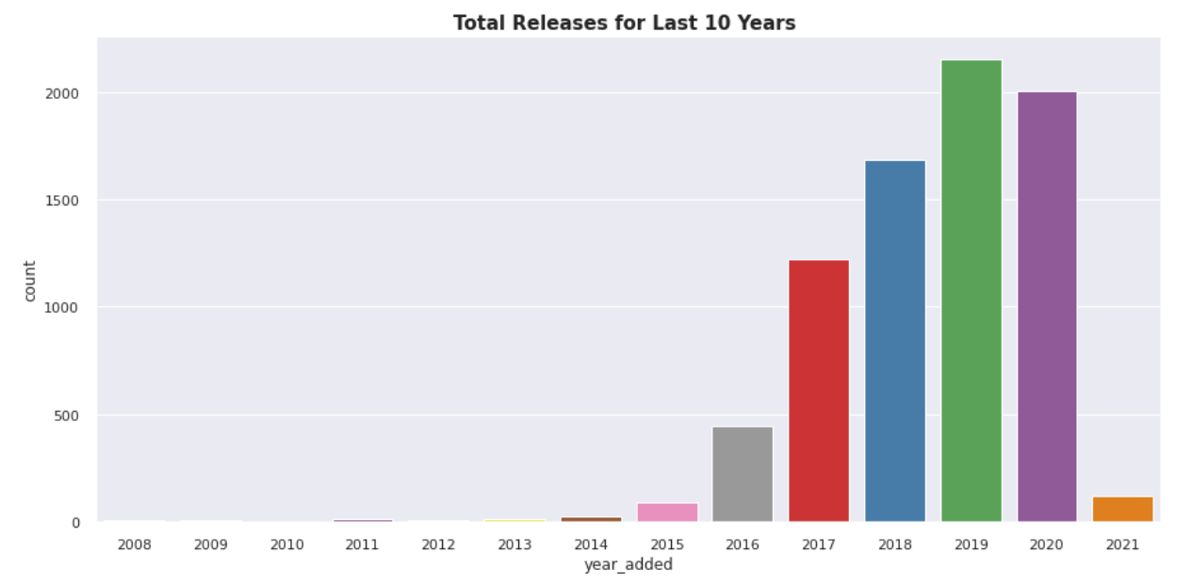
Exploratory Data Analysis
Releases over the year
The number of release have significantly increased after 2015 and have dropped in 2021
because of Covid 19

Slide 9
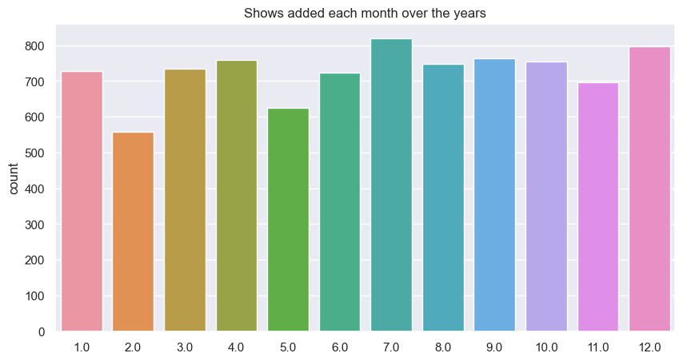
Exploratory Data Analysis

Slide 10
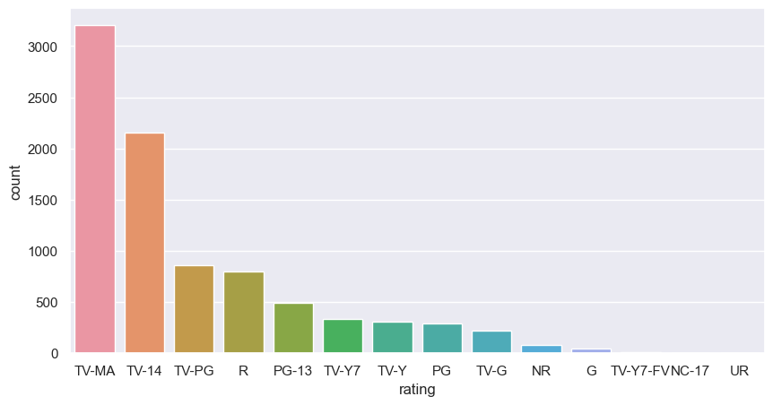
Exploratory Data Analysis

Slide 11
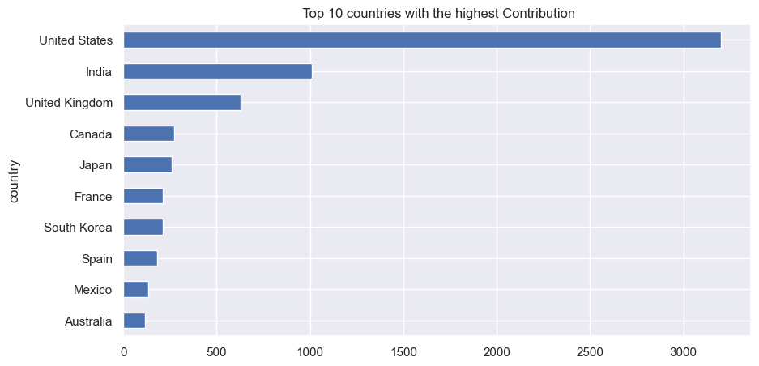
Exploratory Data Analysis
Documentaries is the most popular genre followed by comedy

Slide 12
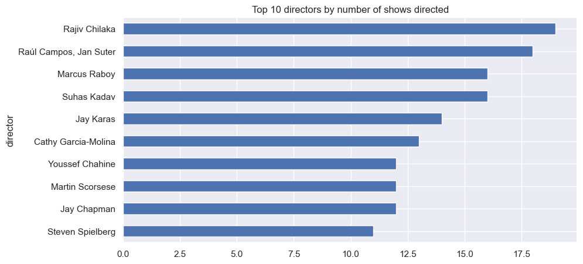
Exploratory Data Analysis

Slide 13
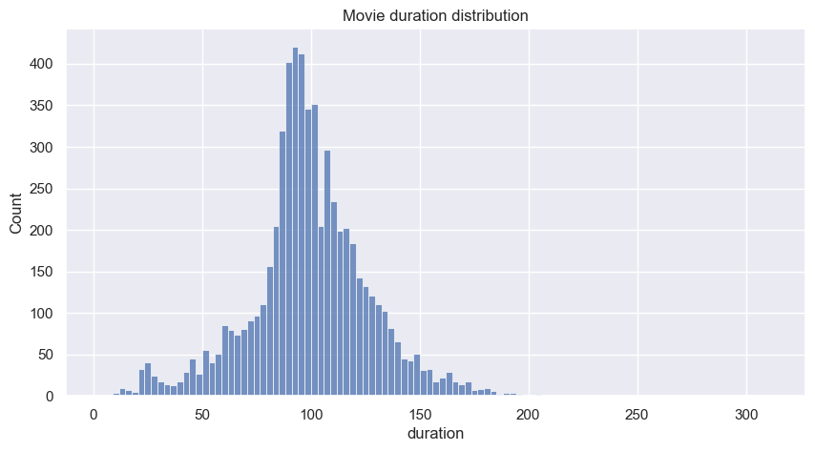
Duration distribution of Movies
Exploratory Data Analysis

Slide 14
Data Cleaning
Label Encoding
Lemmatisation- Lemmatization, unlike Stemming, reduces the inflected words properly ensuring that the root word belongs to the language. In Lemmatization root word is called Lemma. ... For example, runs, running, ran are all forms of the word run, therefore run is the lemma of all these words.
Removing Stop words - To remove stop words from a sentence, you can divide your text into words and then remove the word if it exits in the list of stop words provided by NLTK.
Tf - idf Vectorization - TF-IDF stands for “Term Frequency — Inverse Document Frequency”.
This is a technique to quantify a word in documents, we generally compute a weight to each word which signifies the importance of the word in the document and corpus. This method is a widely used technique in Information Retrieval and Text Mining.
Min-max Scaling - For each value in a feature, MinMaxScaler subtracts the minimum value in
the feature and then divides by the range. It preserves shape of original distribution.

Slide 15

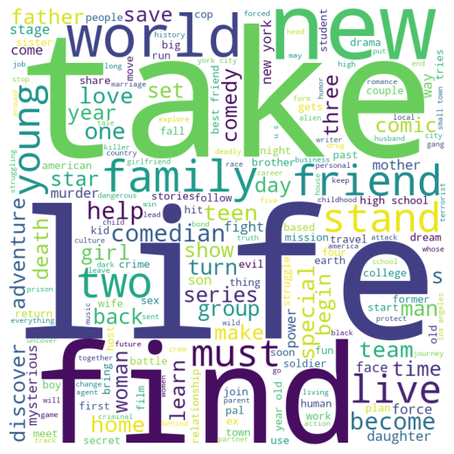
Word Cloud

Slide 16
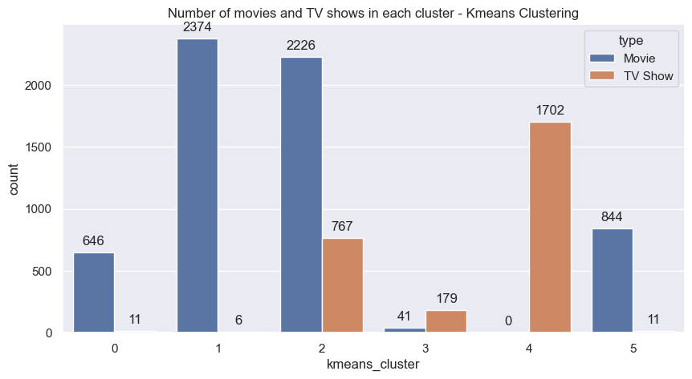
Model Implementation
3. k-means clustering
Here is the Silhouette analysis done on the above plots to select an optimal value for n_clusters.
The value of 4 and 5 for n_clusters looks to be the optimal one. The silhouette score for each cluster is above average silhouette scores.
For n_clusters = 2 The average silhouette_score is : 0.7049787496083262
For n_clusters = 3 The average silhouette_score is : 0.5882004012129721
For n_clusters = 4 The average silhouette_score is : 0.6505186632729437
For n_clusters = 5 The average silhouette_score is : 0.56376469026194
For n_clusters = 6 The average silhouette_score is : 0.4504666294372765

Slide 17
K - Means
To process the learning data, the K-means algorithm in data mining starts with a first group of randomly selected centroids, which are used as the beginning points for every cluster, and then performs iterative (repetitive) calculations to optimize the positions of the centroids
It halts creating and optimizing clusters when either:
The centroids have stabilized — there is no change in their values because the clustering has been successful.
The defined number of iterations has been achieved

Slide 18
K-Means Clustering
K-means algorithm is an iterative algorithm that tries to partition the dataset into K pre defined distinct non overlapping subgroups where each data point belongs to only one group.
1. Elbow Curve:
● The Elbow Curve is one of the most popular methods to determine this optimal value of k.
● The elbow curve uses the sum of squared distance (SSE)to choose an ideal value of k based on the distance between the data points and their assigned clusters.
2. Silhouette score :
● Silhouette score is used to evaluate the quality of clusters created using clustering algorithms such as K Means in terms of how well samples are clustered with other samples that are similar to each other.

Slide 19
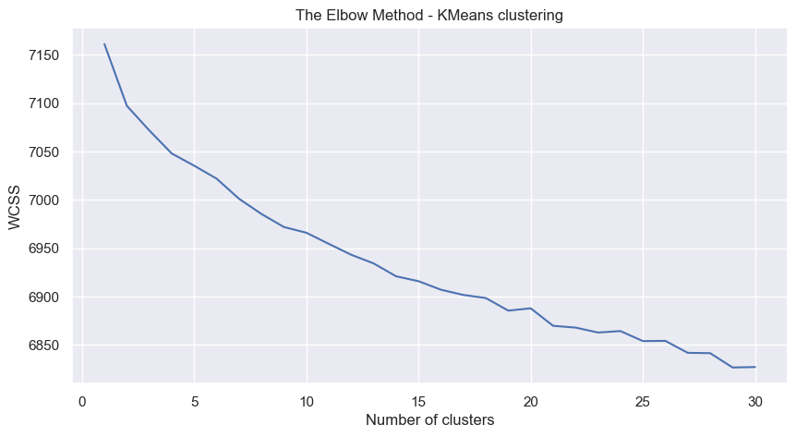
K-Means

Slide 20
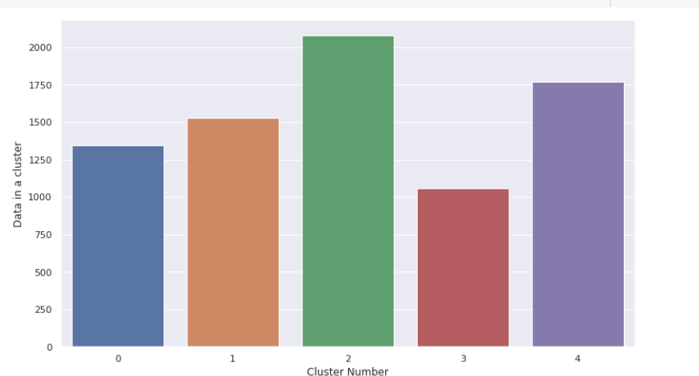
Clusters
We clearly see that one cluster is the largest and one cluster has the fewest number of movies.

Slide 21

Run dashboard app

Slide 22

Conclusion
Data set contains 7787 rows and 12 columns in that cast and director features contains large number of missing values so we can drop it.
We have two types of content TV shows and Movies (30.9% contains TV shows and 69.1% contains Movies).
Most films were released in the years 2018, 2019, and 2020 and united states have the maximum content on Netflix.
The months of October, November, December and January had the largest number of films and Tv-shows released.
The USA, India, the United Kingdom, Canada, and Egypt are the top five producer countries.
For the clustering algorithm, we utilized type, director, nation, released year, genre, and year.
LDA and LSA has sorted much more similar titles in a group of genre.
Applied different clustering models Kmeans, hierarchical, Agglomerative clustering on data we got the best cluster arrangements.
In Affinity Propagation, we had 13 clusters and a Silhouette Coefficient score of 0.244.
We cut vertical lines with a horizontal line to obtain the number of clusters in Agglomerative Clustering. There were four clusters, with an average silhouette score of 0.0039357 The final model we used was k-means clustering, which consisted of 2,3,4,5,6 clusters. 5 numbers of clusters gives us good fitting.
After applying K - means optimal value of number of clusters is 5
Silhouette score for a set of sample data points is used to measure how dense and well-separated the clusters are.
.

Slide 23
Thank you

